Slide 1

College of Lake County
Who They Are?
College of Lake County is a public college with a variety of programs serving the area of Grayslake, IL, just a 1-hour drive from Chicago.
What We Did
Affirma supported CLC by engaging in two key project phases, beginning with a comprehensive discovery phase.
Discovery
Affirma worked directly with key stakeholders at CLC to understand how their business objectives would be serviced by functionality within O365. Affirma provided detailed Recommendations, along with a Roadmap document that clearly outlined an implementation strategy for a SharePoint Intranet and highly custom functionality in Microsoft Teams.
Implementation
Developed a custom Teams Provisioning solution that automatically creates Teams based on a specifically developed template, including automating integrations with additional tools such as MS Planner.
Created a PowerApp form allowing users to submit requests for new Teams to be provisioned
Configured a PowerAutomate workflow that notifies IT managers of the submitted request and allows them to approve/deny the creation of a new team.

Slide 2
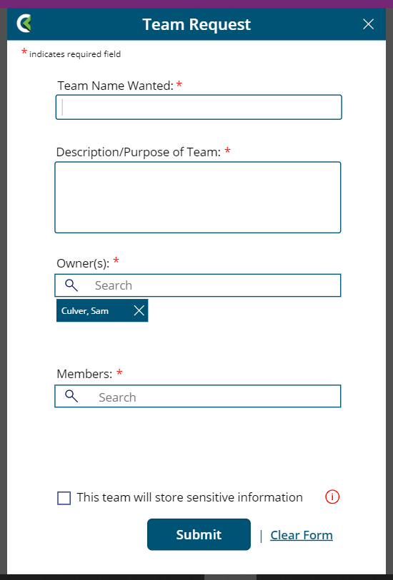
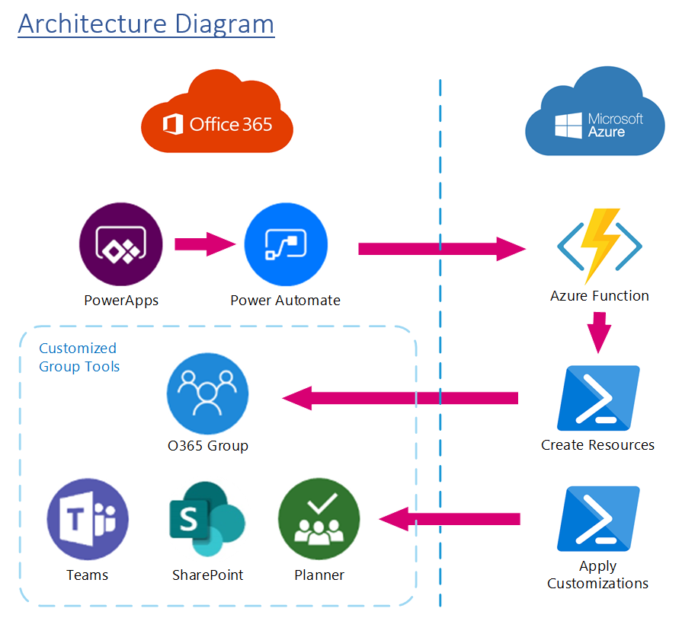
College of Lake County - Continued
Proposed Architecture
PowerApp Form

Slide 3
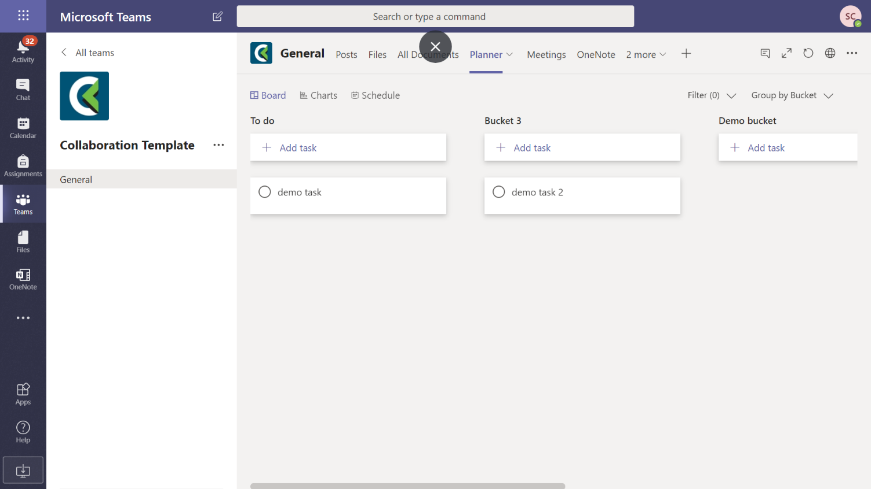
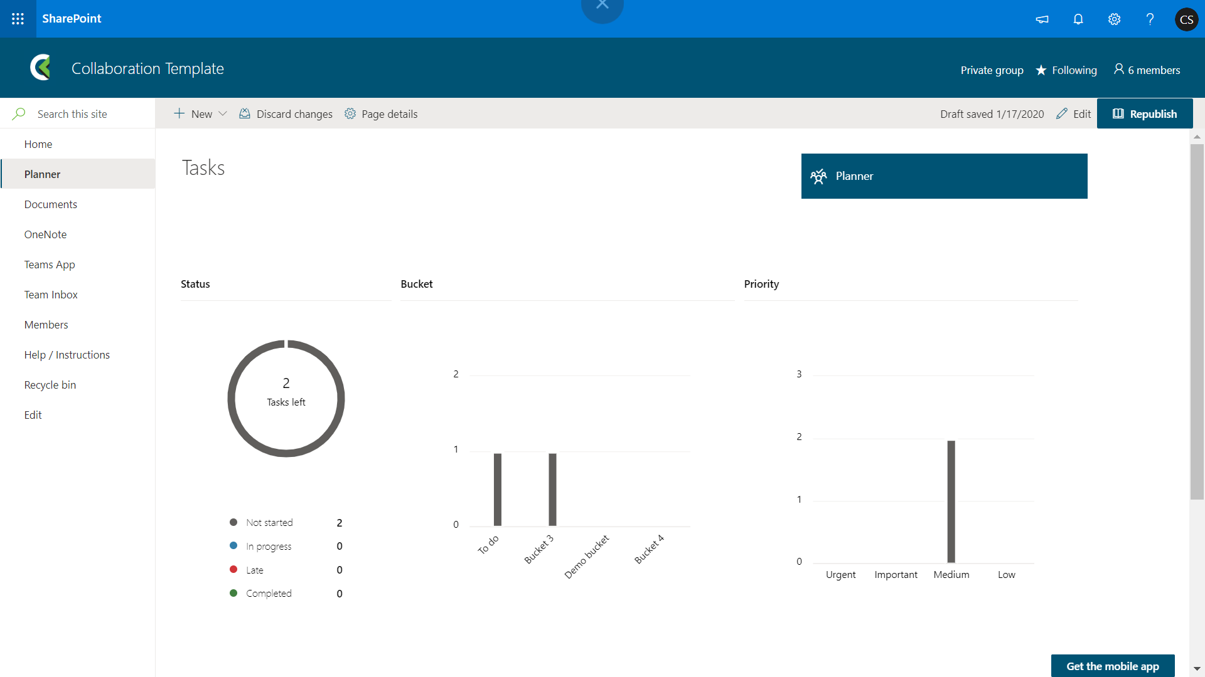
College of Lake County - Continued
Planner Template

Slide 4
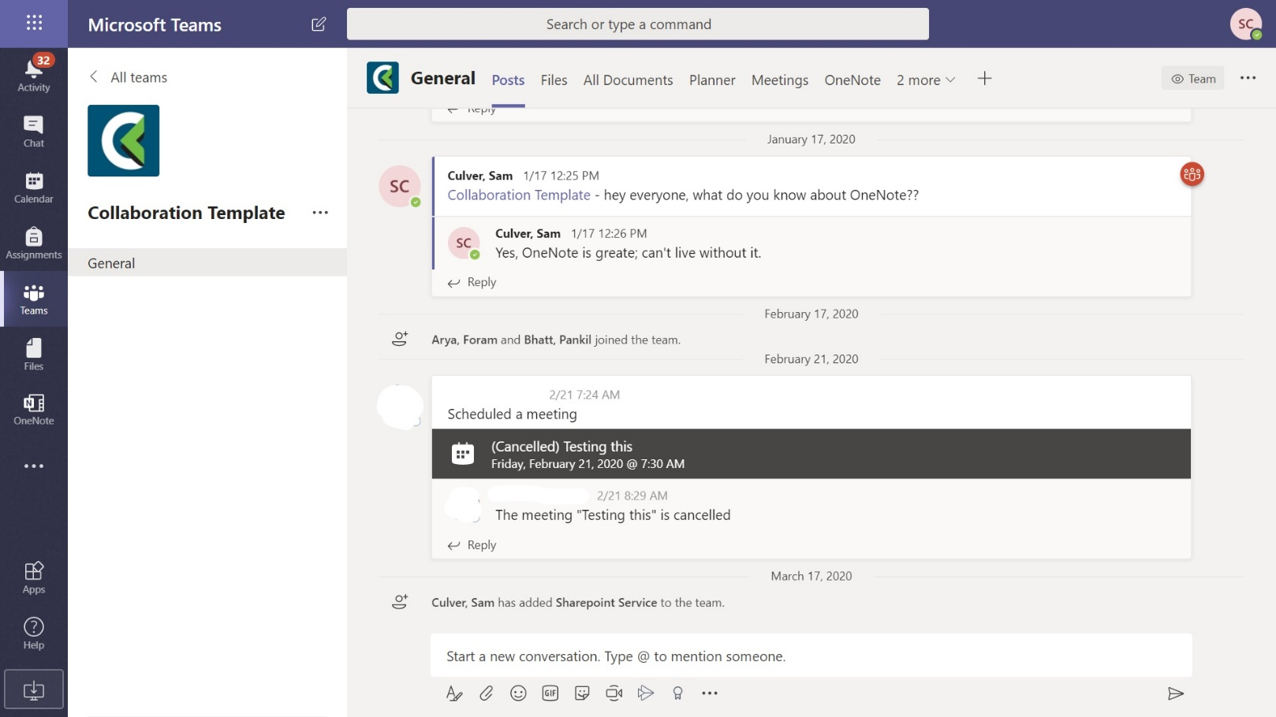
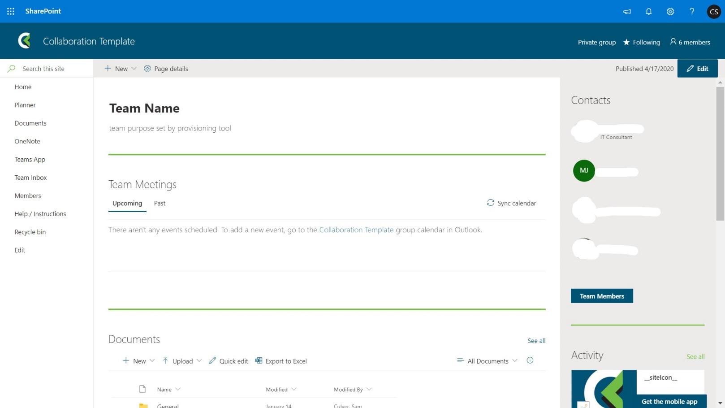
College of Lake County - Continued
Teams Navigation Template
Team Site Template

